Slide 1
FUNDAMENTALS OF
SPACTIAL FILLTERING
Notes:
Today I’ll be presenting on FUNDAMENTALS OF SPACTIAL FILLTERING
– a fundamental technique used to enhance image quality before deeper analysis.

Slide 2
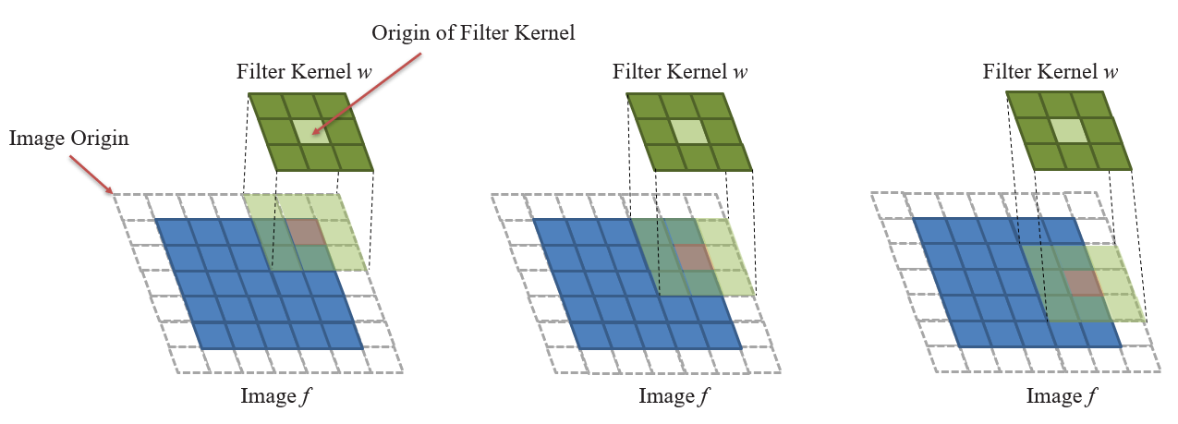
SPACTIAL FILLTERING
Spatial filtering modifies pixel values using their neighbors.
Operates in the spatial domain
Used for:
Smoothing
Sharpening
Edge detection
Notes:
Spatial filtering is the process of modifying a pixel value by considering the values of its surrounding neighbors.
This technique operates directly in the spatial domain of the image.
It is used for smoothing, enhancing, or detecting edges.
A linear spatial filter performs a sum-of-products operation between an image f and a filter kernel, w.
A filter kernel is a matrix that have size 3x3, 5x5 and so on.
Any terms used to refer to a spatial filter kernel are mask, template, and window.

Slide 3
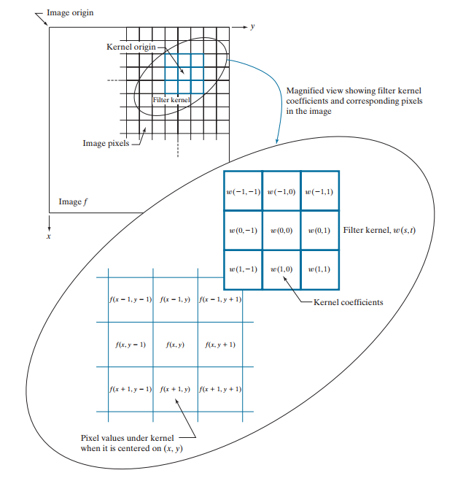


How it work ?
With a kernel of size m x n → m = 2a + 1 and n = 2b + 1
Notes:
This figure illustrates the mechanics of linear spatial filtering using a 3 multiply 3 matrix.
At any point (x, y) in the image, the response, g (x , y), of the filter is the sum of products of the kernel coefficients and the image pixels encompassed by the kernel: As coordinates x and y are varied, the center of the kernel moves from pixel to pixel, generating the filtered image, g, in the process.
Observe that the center coefficient of the kernel, w( , 0 0), aligns with the pixel at location ( , ). x y
From the formula above, we derive the general formula as shown here.
For a kernel of size m multiply ν , we assume that m a = + 2 1 and n b = + 2 1
s takes values from Negative a to a. and t have range from Negative b to b

Slide 4
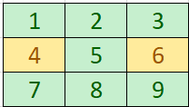

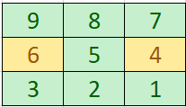

SPATIAL CORRELATION AND CONVOLUTION
w
Correlation
Rotated w
Convolution
Notes:
Correlation consists of moving the center of a kernel over an image, and computing the sum of products at each location. The mechanics of spatial convolution are the same, except that the correlation kernel is rotated by 180°.

Slide 5
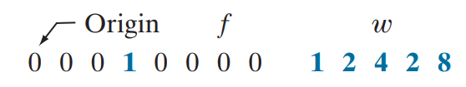
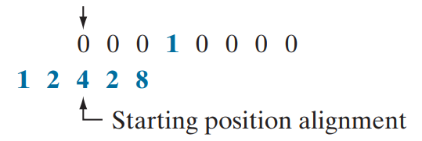
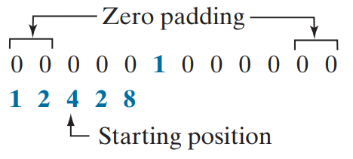
SPATIAL CORRELATION AND CONVOLUTION
Correlation
W size 1 x 5 (1 x m)
=> Padding (m – 1) / 2 = 2 zeros on either side
Notes:
An example of a 1-D function, f, and a kernel, w.
A function that contains a single 1 with the rest being 0’s is called a discrete unit impulse. Due to the center of the kernel coincides with the origin of the image, we need set part of w lies outside f.
So the summation is undefined in that area.
A solution to this problem is to pad function f with enough 0’s on either side.
In general, if the kernel is of size 1 ⋅ m, we need (m – 1) / 2 zeros on either side of f in order to handle the beginning and ending configurations of w

Slide 6




SPATIAL CORRELATION AND CONVOLUTION
Correlation
Start position
Result = 1x0 + 2x0 + 4x0 + 2x0 + 8x1
Position after 1 shift
Result = 1x0 + 2x0 + 4x1 + 2x0 + 8x0
Position after 3 shift
Final Position
Notes:
Correlating a kernel with a discrete unit impulse yields a rotated version of the kernel at the location of the impulse.
the result is a copy of the kernel, rotated by 180°

Slide 7
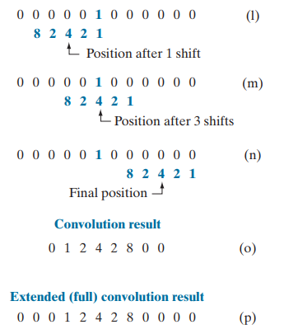
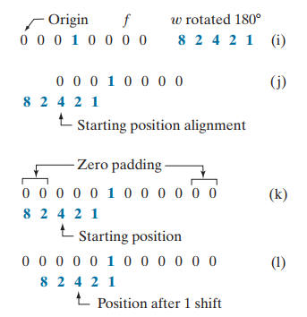
SPATIAL CORRELATION AND CONVOLUTION
Convolution
Notes:
You see again
that convolution of a function with an impulse copies the function to the location of the impulse.

Slide 8
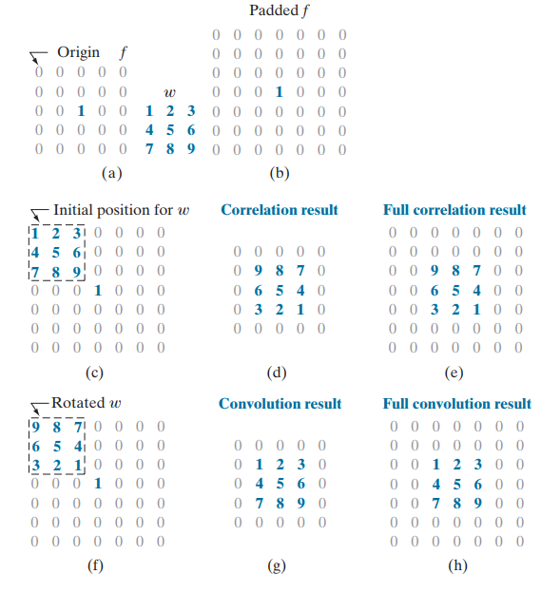
SPATIAL CORRELATION AND CONVOLUTION
In spatial filtering, the filter mask (or kernel) depends on two main factors:
- Kernel Size (Mask Dimensions)
+ Small kernels (e.g., 3×3) preserve more details.
+ Larger kernels (e.g., 5×5 or more) smooth more aggressively but may blur important features.
- Kernel Coefficients (Weights):
+ Uniform coefficients → Smoothing (Box filter).
+ Centered high weights → Gaussian blur.
+ Positive and negative values → Edge detection
Notes:
This refers to the size of the filter matrix, commonly odd dimensions like 3×3, 5×5, 7×7, etc., so that the filter has a central pixel.
The size determines the neighborhood of pixels that will influence the output:
Small kernels (e.g., 3×3) preserve more details.
Larger kernels (e.g., 5×5 or more) smooth more aggressively but may blur important features.
These are the numerical values inside the kernel that determine how each neighboring pixel contributes to the result.
They define the type of filtering:
Uniform coefficients → smoothing (e.g., mean filter).
Centered high weights → Gaussian blur.
Positive and negative values → edge detection (e.g., Sobel, Laplacian).

Slide 9
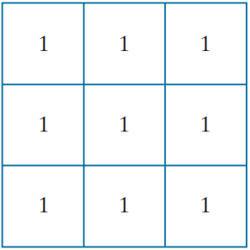
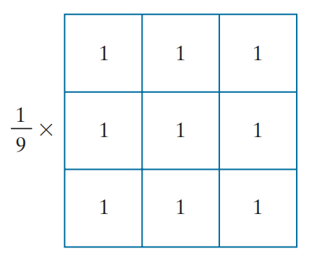
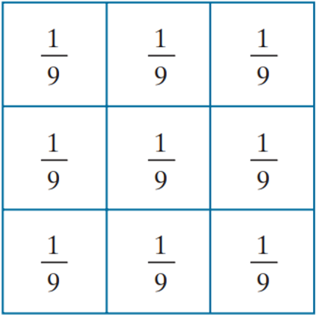
BOX FILTER KERNEL
Normalize
Box filter kernel
Sum of the value of the coefficients = 9
Normalize:
To ensure that the sum of all values in the kernel equals 1.
When applied to a region with uniform intensity (e.g., all pixels have a gray value of 100), the filtered result should retain the same intensity.
To prevent increasing or decreasing the overall brightness of the image (i.e., to avoid altering the overall color balance).
Notes:
The simplest, separable lowpass filter kernel is the box kernel, whose coefficients of kernel have the same value (typically 1)

Slide 10




BOX FILTER KERNEL
Test pattern
size 1024x1024 pixels
Filtering with box kernels of sizes 3x3
Filtering with box kernels of sizes 11x11
Filtering with box kernels of sizes 21x21
Notes:
4 Figure shows the results of applying kernel filters of different sizes to a test pattern image of size 1024 × 1024 pixels.
For m = 3, we note a slight overall blurring of the image The filtered image also has a thin gray border, the result of zero-padding the image prior to filtering Using the 11 11 ⋅ kernel resulted in more pronounced blurring throughout the image, including a more prominent dark border
The result with the 21 21 ⋅ kernel shows significant blurring of all components of the image, including the loss of the characteristic shape of some components, including, for example, the small square on the top left and the small character on the bottom left. The result with the 21 21 ⋅ kernel shows significant blurring of all components of the image, including the loss of the characteristic shape of some components, including, for example, the small square on the top left and the small character on the bottom left.

Slide 11
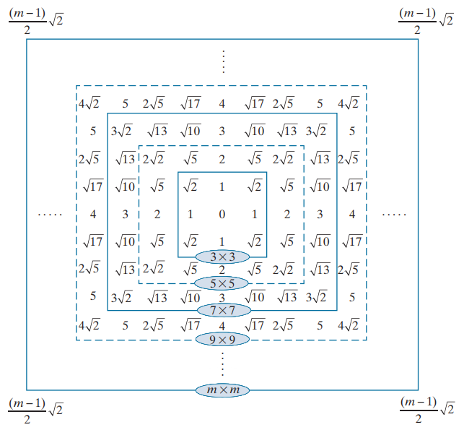




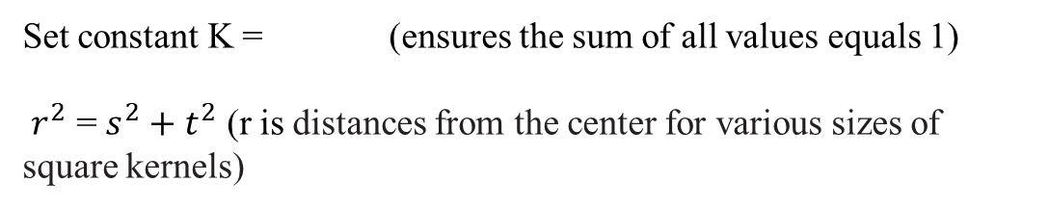
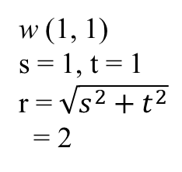
GAUSSIAN FILTER KERNEL
w (1, 1)
s = 1, t = 1
r = $\sqrt{s^{2}+t^{2}}$
= 2
s, t: The pixel distances from the center of the kernel
σ: The standard deviation (controls the amount of blur)
Set constant K = (ensures the sum of all values equals 1)
$r^{2}$ = $s^{2}+t^{2}$ (r is distances from the center for various sizes of square kernels)
Distances from the center for various sizes of square kernels.
Notes:
A Gaussian kernel filter (or Gaussian blur) is a type of image processing filter used to smooth or blur images and remove noise. It's based on the Gaussian function

Slide 12
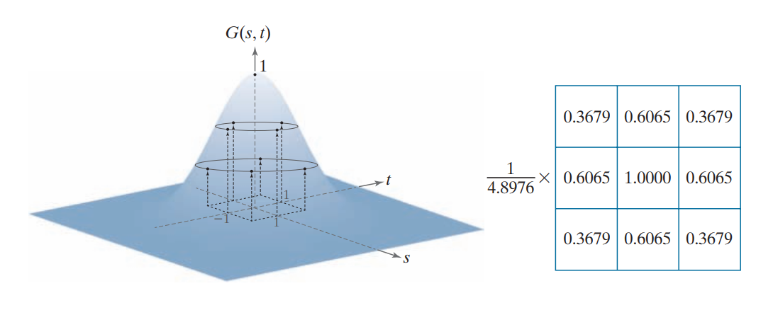

GAUSSIAN FILTER KERNEL
With s = -1 and t = -1
Constant K
Bell shape of the Gaussian function
Sum of the value of the coefficients

Slide 13




Comparing the Box kernel and the Gaussian kernel
Original image
Box kernel 21x21
Gaussian kernel 21x21
Gaussian kernel 43x43
Notes:
Comparing the Box kernel and the Gaussian kernel you'll notice that with kernels of the same size, the box kernel blurs and distorts the shape of the image, while the Gaussian kernel only blurs it. Compared to a 43x43 Gaussian kernel, we see that the level of blur is similar, but when using the Gaussian kernel, the shapes of the details are still preserved. Therefore, in image processing, when the goal is to smooth the image, the Gaussian kernel is more commonly used."

Slide 14
SPACTIAL FILLTERING
Origin of Filter Kernel
Filter Kernel w
Filter Kernel w
Filter Kernel w
Image Origin
Image f
Image f
Image f
Notes:
A filter kernel is a matrix that have size 3x3, 4x4, etc

Slide 15
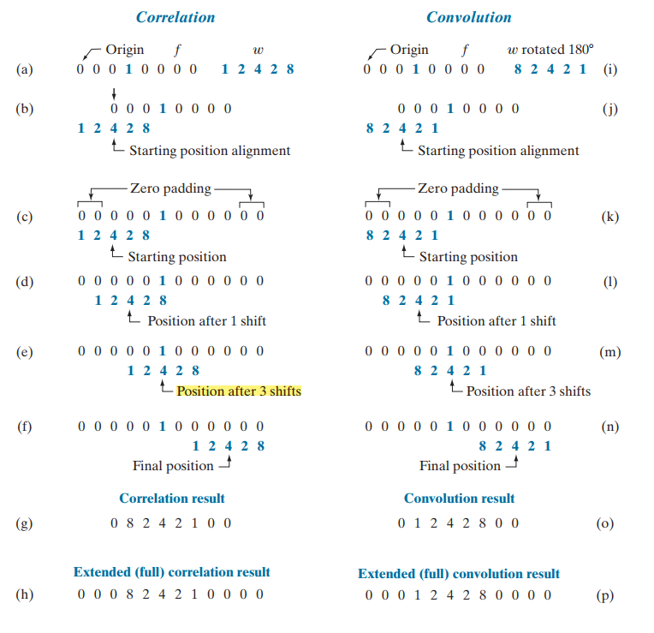
SPATIAL CORRELATION AND CONVOLUTION

